Slide 1

Building Our First Duplicate Entry Merger Tool
A journey through web scraping, data analysis, and problem-solving as first-year college students learning to code from scratch.

Slide 2
Starting from Zero
  Our Reality
As first-year students, we entered this project with very basic coding knowledge. We quickly realised that breaking down the problem into manageable pieces was key to success.
Our Approach
Rather than diving into complex implementations, we divided my project into three distinct phases.
This phased approach helped us learn progressively whilst building confidence with each milestone.

Slide 3
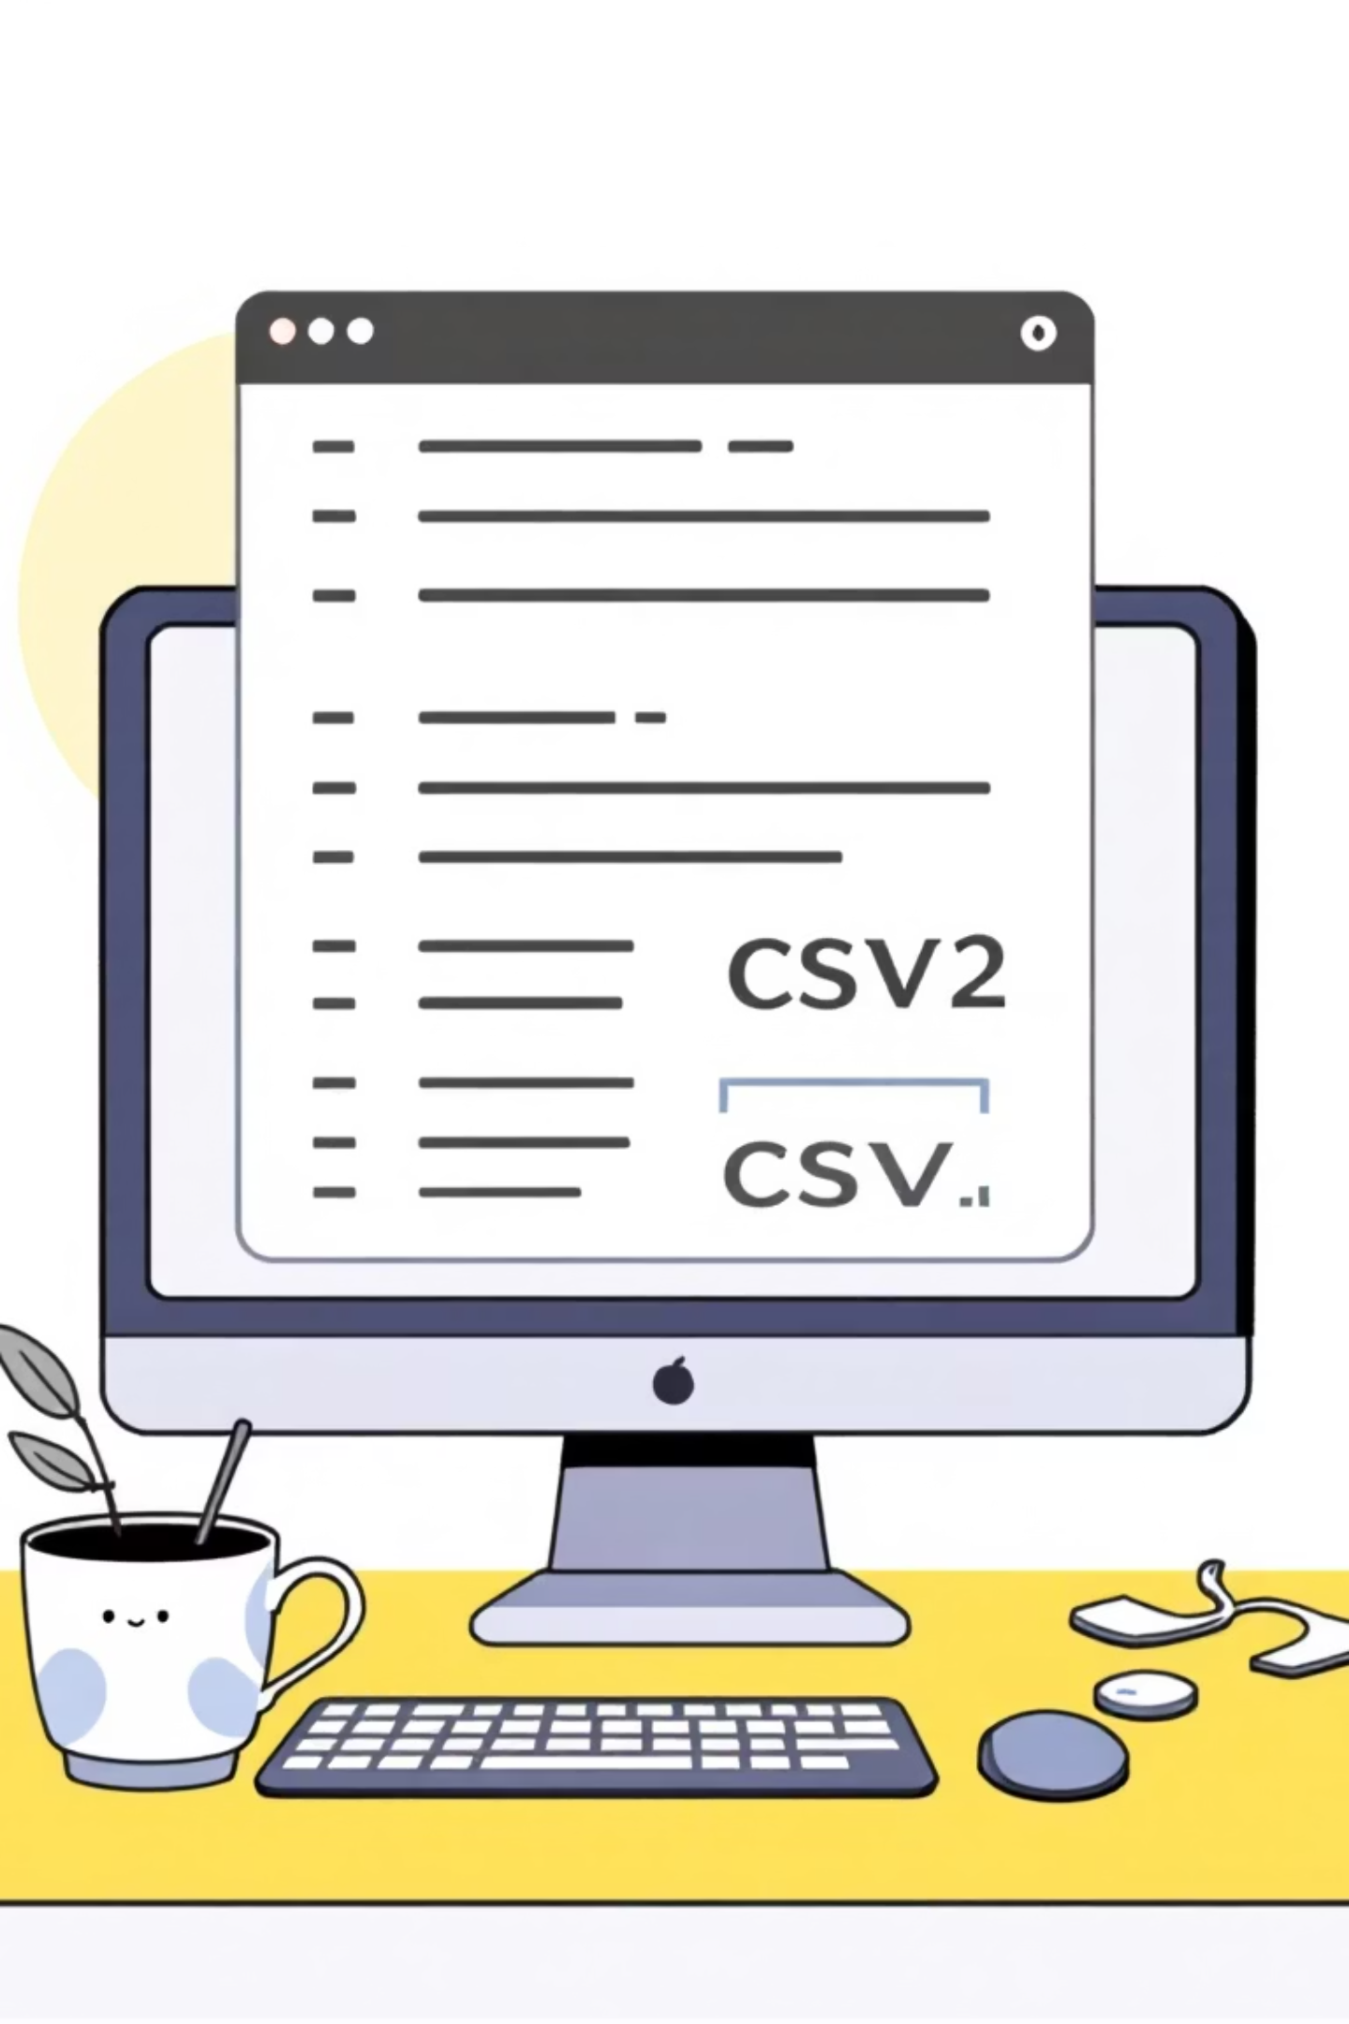
Phase 1: Understanding the Basics
Before tackling massive datasets like Google Shopping, we needed to understand fundamentals. We started small—creating and working with a custom CSV file that we could fully control and comprehend.

Slide 4
Learning by Doing with CSV Files
01
02
03
Data Exploration
Data Cleaning
Data Organisation
We discovered Python libraries like Pandas that made data manipulation surprisingly accessible.
ChatGPT became our coding mentor, explaining concepts as we experimented.
We learnt to filter entries, convert text to lowercase, and remove unnecessary characters like commas, periods, and brackets that cluttered our data.
Our code grouped similar product names together, extracting key information like product names, prices, and seller details into organised lists.
Each step taught us something new about how data flows through code.

Slide 5
                Phase 2: Connecting to the Real World
Learning Moment:
We discovered that scraping data legally and ethically required understanding APIs and terms of service.
With CSV basics mastered, we faced our biggest challenge: bringing live internet data into our programme. This was the original goal, and it felt both exciting and daunting. Initial research introduced us to web scraping libraries like BeautifulSoup, which opened up possibilities for extracting data directly from websites.

Slide 6
Discovering SerpApi
The Challenge
The Solution
The Implementation
Directly scraping Google Shopping raised legal concerns. We needed a legitimate way to access product listings whilst respecting Google's policies and infrastructure.
SerpApi became our bridge to Google's data. This service legally provides structured access to search engine results, including Google Shopping listings, through a clean API interface.
Instead of parsing raw HTML, SerpApi delivered organised JSON data containing product names, prices, sellers, and ratings—exactly what our comparison tool needed.

Slide 7



Phase 3: Polishing & Integration
File Integration
User Input
Testing
Connected our sorting algorithms with the scraping module for seamless data flow.
Implemented custom search functionality so users could query any product they wanted.
Ran countless tests to identify bugs and improve reliability of results.

Slide 8
Key Challenges We Overcame
🧩 Debugging Errors
📚 Library Documentation
Learning to read error messages and troubleshoot issues that seemed impossible at first.
Understanding technical documentation for Pandas, SerpApi, and other tools without prior experience.
🔄 Data Consistency
Ensuring our programme handled different data formats and unexpected inputs gracefully.

Slide 9
A Working Price Comparison Tool
Our final programme accepts user search queries, fetches live product data from Google Shopping via SerpApi, cleans and organises the information, and presents comparable results—all built from scratch by first-year students.
What We Built
Is it perfect? Absolutely NOT. To be very honest, it is a very basic and a simple
program that just loads data from Google Shopping tab and compares the
price; sorts and merges all the duplicate entries into one and lists the
lowest price available for a particular product at any given point of time.
But it works, and we built it ourselves with the help of AI of course.

Slide 10
Mohsin Syed - ICE
Ninad Joshi - ECE
Vaishnav Ghutake - ECE
Nakul Bachani - MME
NIT Trichy

